Slide 1
Milk Tea Mini Shop Management
Class Name: PF08 Group Name: Group_2
Member: Nông Hồng Cương
Nguyễn Long Nhật

Slide 2
Objectives
Build a console app to help user manage our milk tea shop more conveniently.

Slide 3
Customer Requirements
Hava basic funtions such as:
Login.
Insert new drink into databases.
Update unit price of existed drinks.
Create order and print out invoices.
Update order.

Slide 4
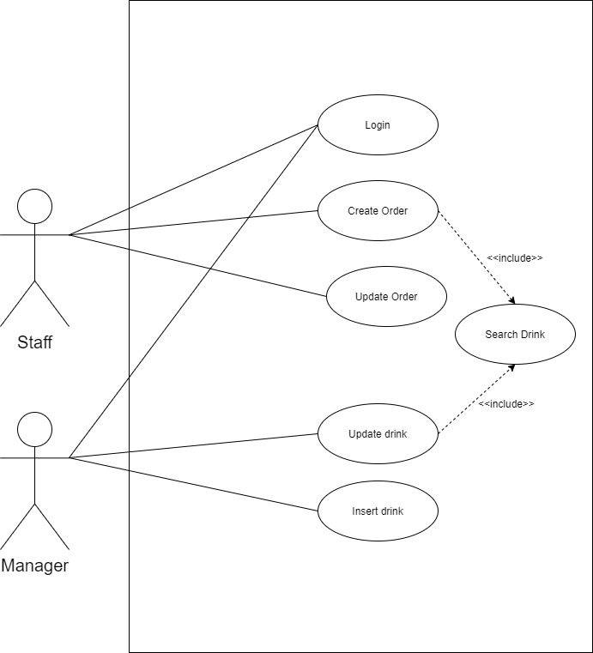
Use Case

Slide 5
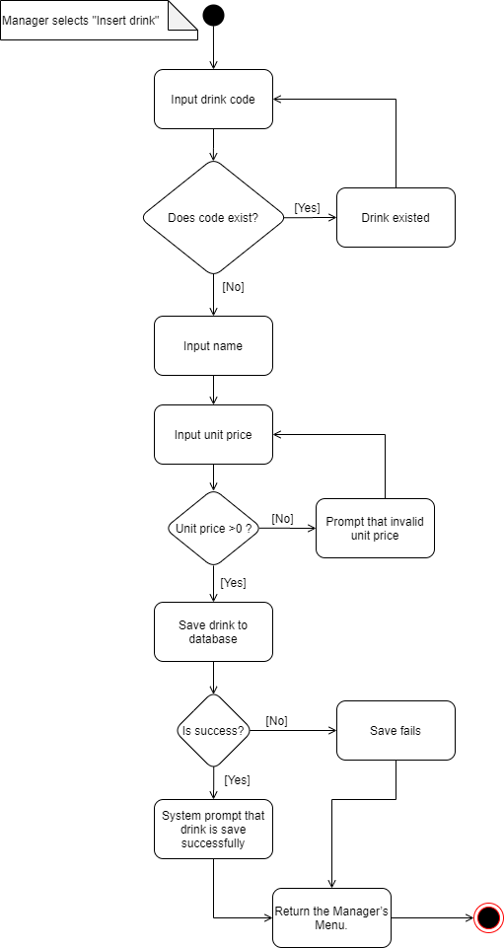
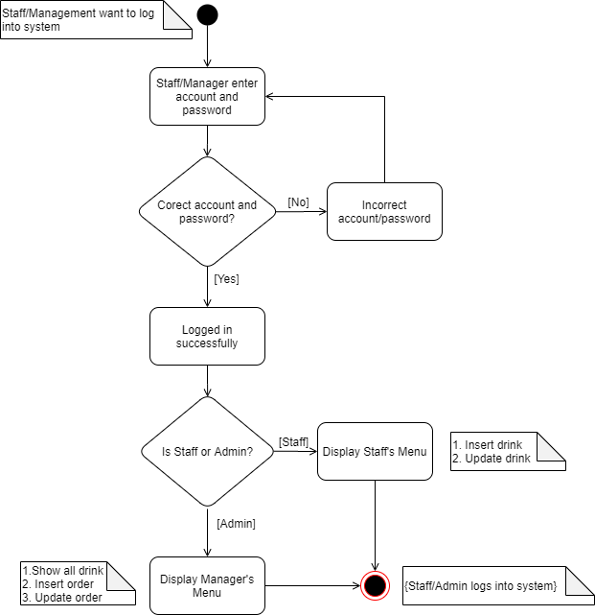
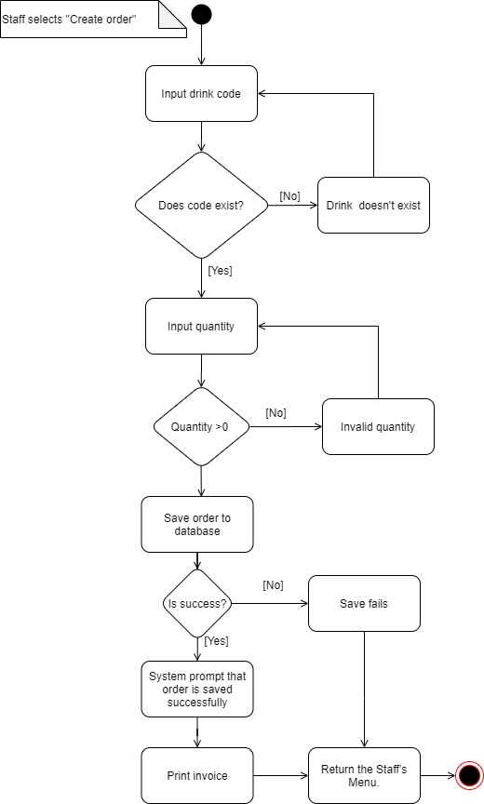

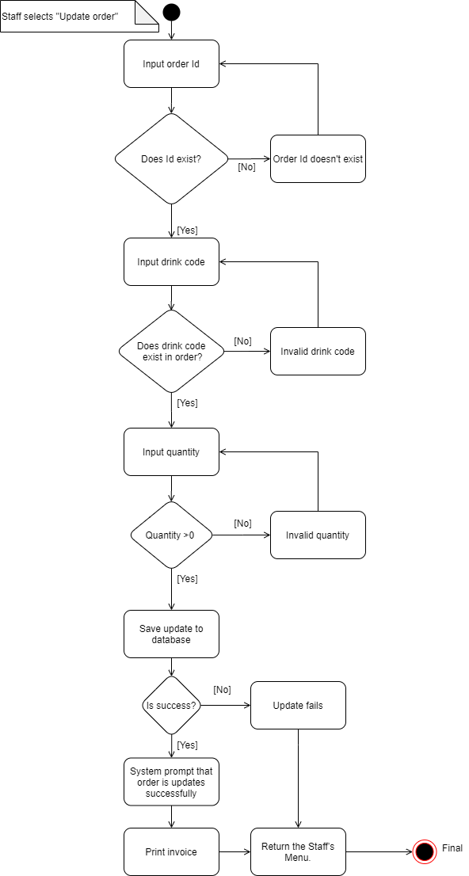
Activity Diagram

Slide 6
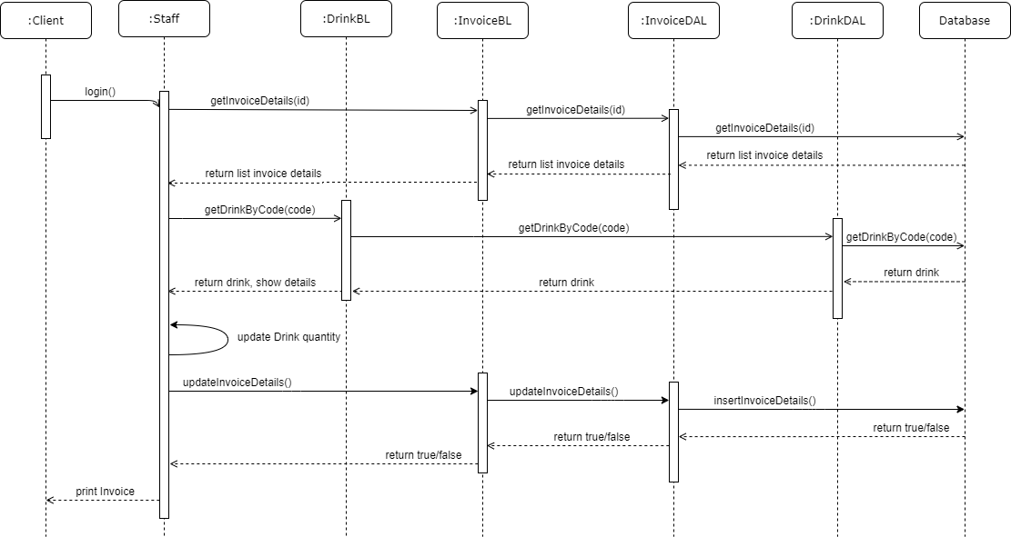
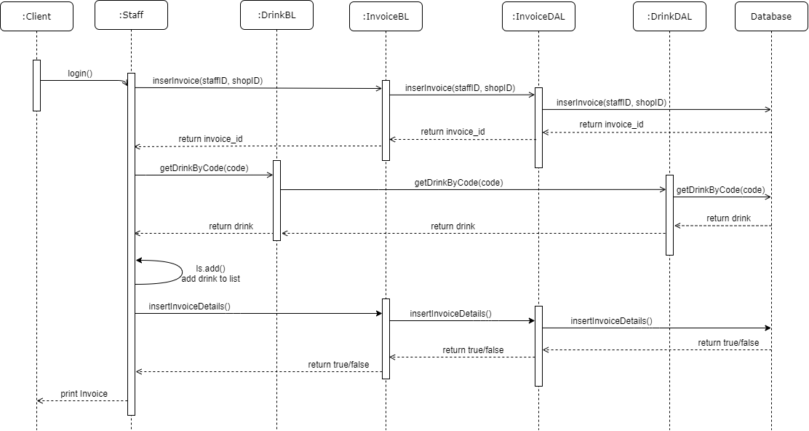
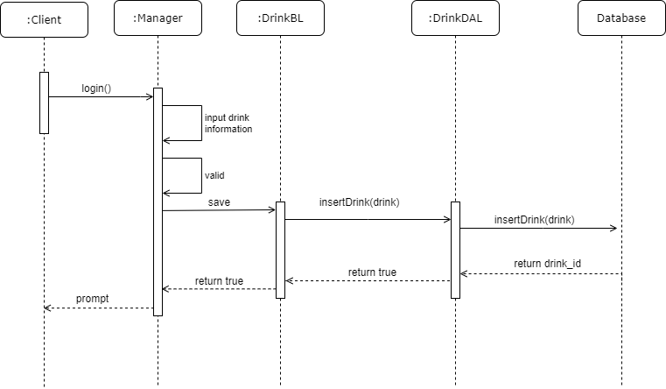
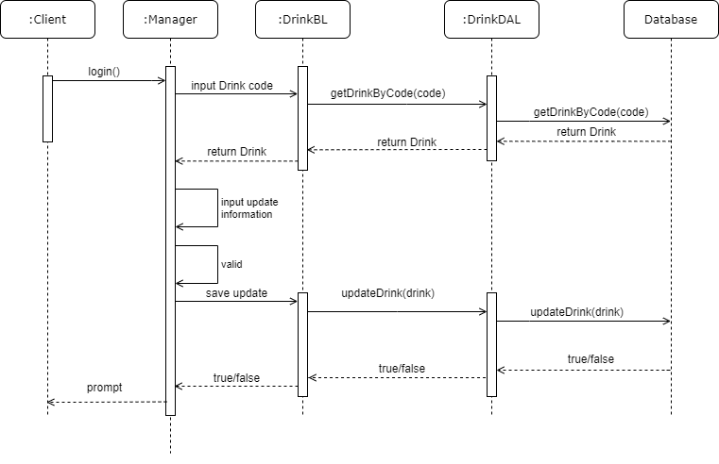
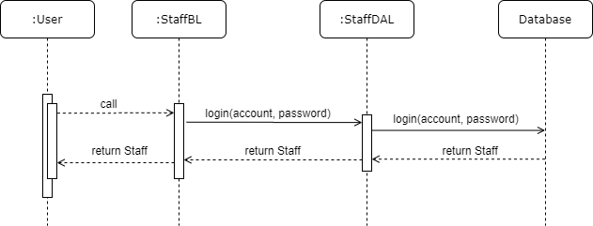
Sequence Diagram

Slide 7
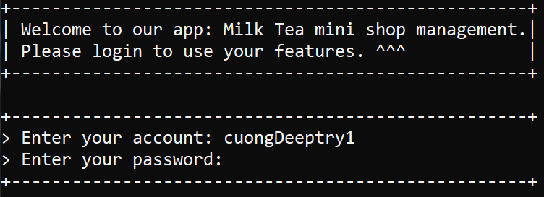




UI Design

Slide 8
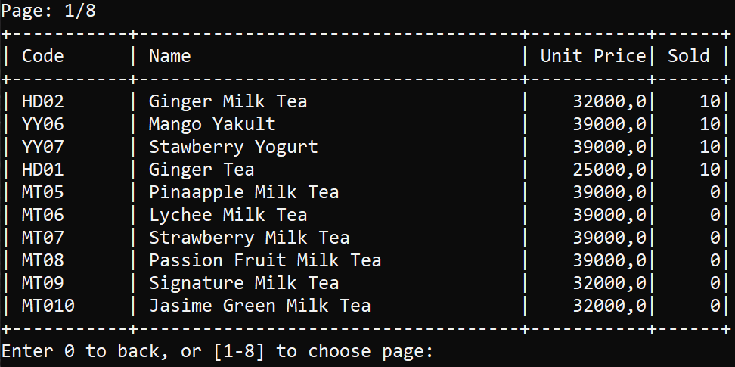
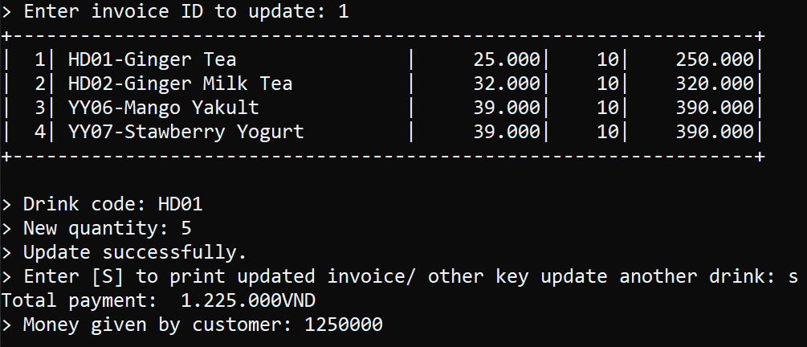
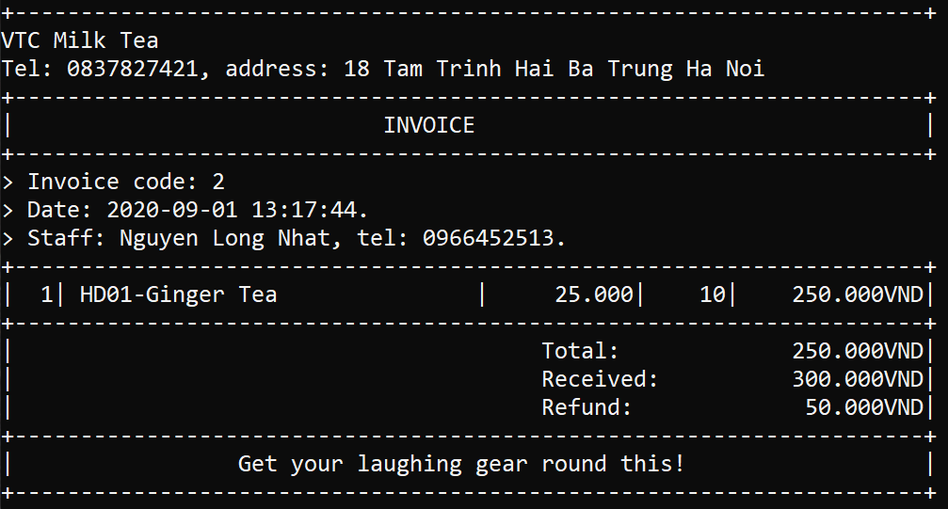

UI Design

Slide 9
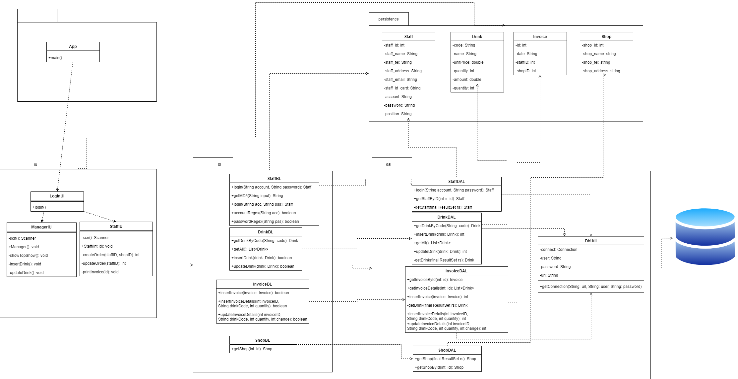
Class Diagram

Slide 10
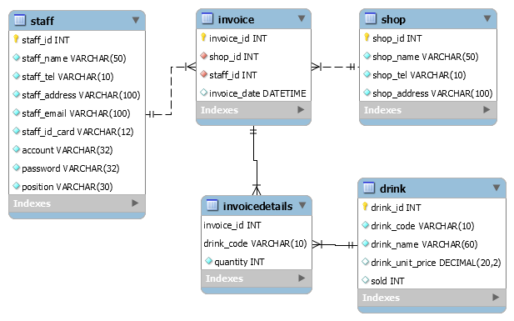
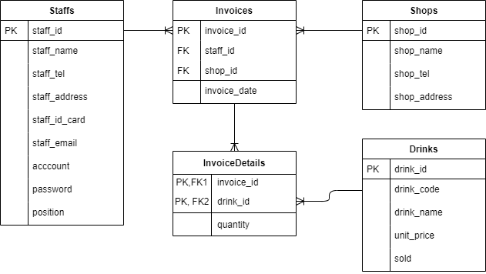
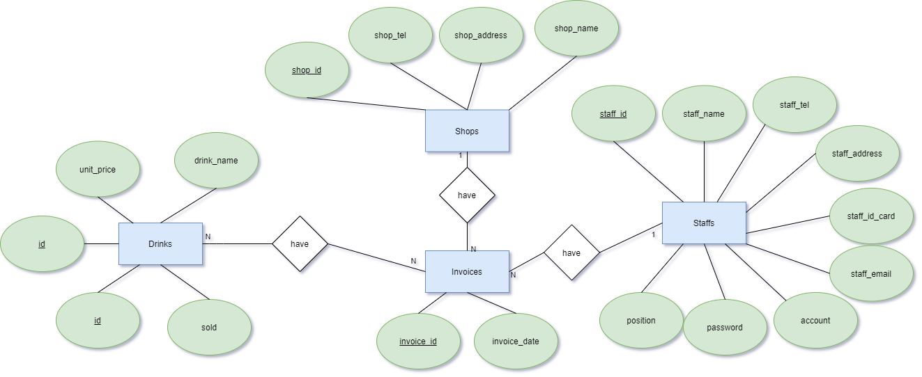
Entity Relationship Diagram

Slide 11
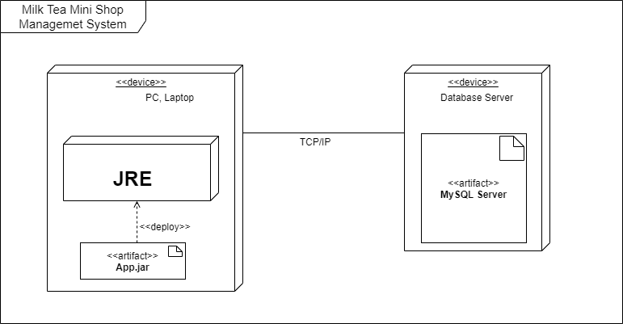
Deployment Diagram

Slide 12
Assign work to each team member

Slide 13


Slide 14
Q & A

